Slide 1
SPATIAL BIG DATA · PROJECT PRESENTATION
Urban Expansion and Green Space Loss Using Spatial Big Data Analytics
A Case Study of Thiruvananthapuram, Kerala, 2000-2025
Presented by: Sebin George (Roll No. 253309)
M.Sc. Semester 3 · Digital University Kerala
Land cover · green · built-up · water
Notes:
How much green space did Thiruvananthapuram lose to buildings between 2000 and 2025? Where did this loss happen, why did it happen there, and which wards should be prioritised for protection?

Slide 2
In 25 years, the city traded 12 km² of green for buildings
74.2%
22.9%
12.2 km²
+1.6 °C
Green cover in 2025
(77.7% in 2000)
Built-up in 2025
(15.6% in 2000)
Green converted to built-up, 2000-2025
Extra surface warming on converted land
Clustered, not scattered. One belt from Pettah and Chakkai to Sreevaraham and Kalippankulam holds 4.5 km² of the conversion.
Infill and roads drive it. Green pockets already ringed by buildings convert at 3.7× the city rate; 12.5% of green within 100 m of a main road was lost, 3.6% beyond 500 m.
Clear places to act. A ward priority index names 20 wards to protect first; Sreevaraham ranks first under every weighting tested.
Notes:
Headline numbers for the corporation (101 wards, 214 km2). Green is tree cover plus other vegetation. The 1.6 degree figure compares Landsat land surface temperature change on converted pixels with pixels that stayed green.

Slide 3
Why this study, and what it set out to do
The problem
1
Measure
Map land cover 2000-2025 from Landsat and Sentinel-2 and quantify green lost per ward
Technopark, Vizhinjam port and capital-region growth push the city outward
Home-garden canopy, paddy and wetland are lost plot by plot
Less green means more runoff, flooding and heat
No ward-level evidence of how much is gone, where, or why
2
Locate
Find where loss clusters: hotspot analysis on hexagons
3
Explain
Find what makes green land likely to be built over: roads, infill, terrain
214 km²
101
25 years
4
Scale and act
study area
wards
2000-2025
Run the analysis on big-data engines and turn it into a ward priority index and dashboard
Notes:
Thiruvananthapuram's green is mostly private home gardens under coconut and mixed tree canopy, not parks, so it disappears plot by plot without any single decision. The Corporation has no ward-level record of how much has gone, where, or why. The four objectives map onto the seven pipeline steps on the next slides.

Slide 4
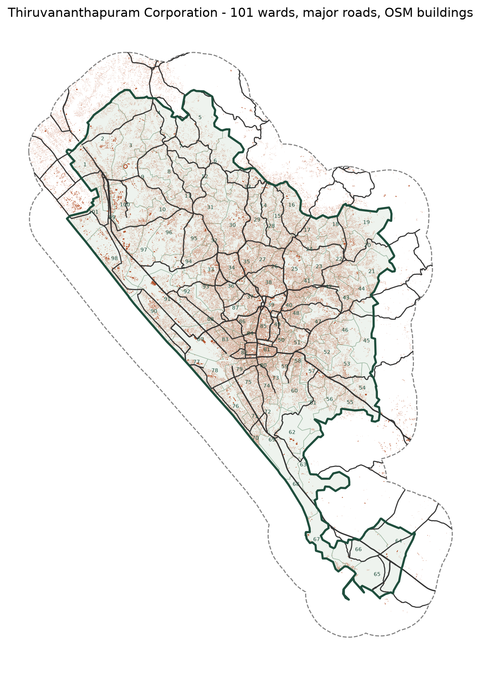
Study area and data
Layer | Source | Used for
Landsat 5/7/8/9, 30 m | Earth Engine dry-season medians: 2000, 2010, 2017, 2025 | Land cover over 25 years
Sentinel-2 L2A, 10 m | Earth Engine, Cloud Score+ mask: 2019, 2025 | Detailed recent map
WorldCover, Dynamic World | ESA, Google | Training labels where both agree
101 ward boundaries | K-SMART 2024 delimitation | Ward statistics
Roads, buildings, land use | OpenStreetMap (Geofabrik) | Drivers and checks
Population, 100 m | WorldPop | Density, green per person
DEM, HAND, LST, radar | Copernicus GLO-30, MERIT Hydro, MODIS, Sentinel-1 | Terrain, heat, floods
Notes:
All imagery was processed in Google Earth Engine and exported on one 30 m UTM 43N grid (and 10 m for Sentinel-2). Census 2011 wards do not match the 2024 delimitation, so population comes from gridded WorldPop aggregated to wards.

Slide 5
Seven steps from satellite pixels to ward decisions
1
Base data
2
Composites
3
Classify
4
Detect change
Wards, OSM roads and buildings, WorldPop
Cloud-masked dry-season medians, NDVI / NDBI / MNDWI
Random Forest, 5 classes, 10 k samples per map
Backdated series, transition matrices
GeoPandas
Earth Engine
scikit-learn
Rasterio
5
Big data engine
6
Analytics
7
Dashboard
4 M pixel points, spatial joins, partitions
Gi*, DBSCAN, FP-Growth, priority index
Maps, drill-down, live spatial queries
Sedona on Spark, PostGIS
PySAL, Spark MLlib
Streamlit, Folium
Notes:
We divided our project into seven major steps. First, we prepared the base geographical data. Second, we collected and preprocessed satellite images to create cloud-free composites. Third, we classified the images into five land-cover classes using Random Forest. Fourth, we detected changes between different years to measure urban expansion and green-space loss. Fifth, we used Spark, Sedona and PostGIS to process large spatial datasets. Sixth, we performed spatial analytics to identify hotspots, construction clusters and priority wards. Finally, we developed an interactive Streamlit dashboard to present and explore the results

Slide 6
The tools, in plain words
Google Earth Engine
Python libraries
PostgreSQL + PostGIS
Cloud platform that filters and composites 25 years of Landsat and Sentinel-2 scenes
Rasterio reads satellite bands, GeoPandas handles ward and road shapes, scikit-learn trains the Random Forest
A free database with spatial SQL: clip, buffer and measure; GiST indexes make spatial queries fast
Apache Spark
Apache Sedona
PySAL, Streamlit, Folium, Plotly
Splits big data across many cores or machines; its MLlib library runs the FP-Growth rules
Spatial add-on for Spark: geometry, spatial indexes and partitioned joins over millions of pixels
Hotspot statistics, and the web dashboard with interactive maps and charts
How they fit: Earth Engine prepares imagery → Python classifies → PostGIS stores and queries → Sedona scales joins → Streamlit shows results
Notes:
For a non-specialist audience: what each tool is and what it did in this project. Earth Engine prepares the imagery, Python classifies it, PostGIS stores and queries the results, Spark and Sedona scale the heavy joins, and Streamlit shows everything in the browser.

Slide 7
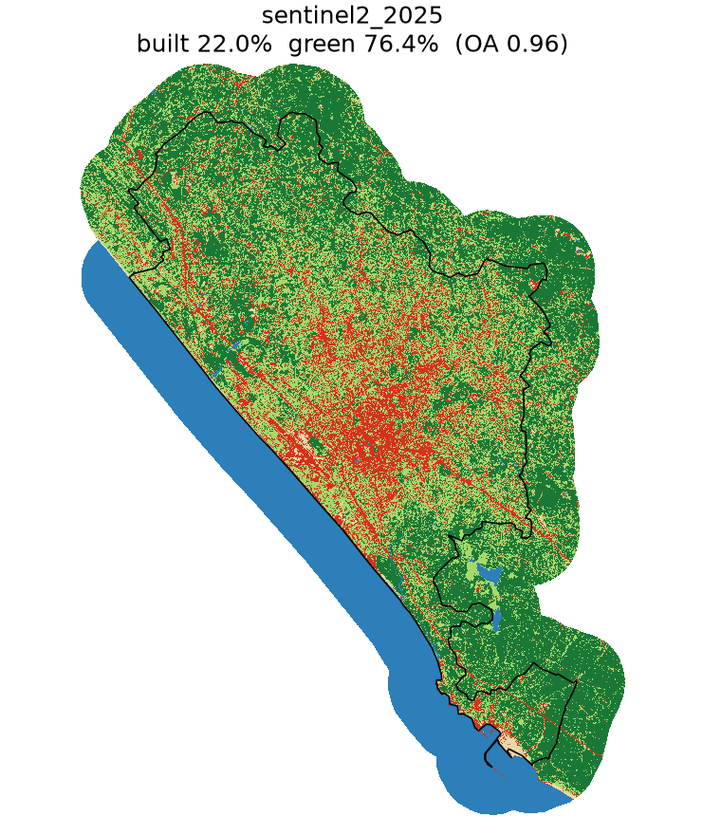
Machine learning models used
Model | Type | Used for | Result
Random Forest | Supervised ML (classification) | Land cover, 5 classes, from bands + indices | Accuracy 0.96 (Sentinel-2), 0.71-0.82 (Landsat)
DBSCAN | Unsupervised ML (clustering) | Groups converted pixels into construction sites | 250 clusters, 58% of conversion
FP-Growth | Unsupervised ML (association rules) | Finds conditions that predict green → built-up | Top rule 5.3× the city rate
Getis-Ord Gi*, Moran's I | Spatial statistics (not ML) | Tests where loss clusters | 262 hot hexagons, I = 0.49
Built-up
Tree
Other veg.
Deep learning: none trained. Two pre-trained Google deep-learning products are used as inputs only: Dynamic World (training labels) and Cloud Score+ (cloud masking).
Water
Bare
Random Forest map, Sentinel-2 2025
Notes:
The main reference datasets were:
ESA WorldCover 2021.
Google Dynamic World.
GHSL (Global Human Settlement Layer).
Spectral information from satellite images.
In your project, we required:
WorldCover and Dynamic World to agree.
At least 7 out of 9 pixels in a 3 × 3 neighbourhood to have the same class.
Additional GHSL and spectral conditions where applicable.
Our procedure was:
Aggregate Sentinel-2's 10 m classification into 30 m pixels.
Assign a class when it covered at least 50% of the 30 m pixel.
For built-up labels, require at least 20% GHSL built-up surface.
For historical years, retain only pixels whose spectral change from 2025 was below the class-specific 75th percentile.

Slide 8
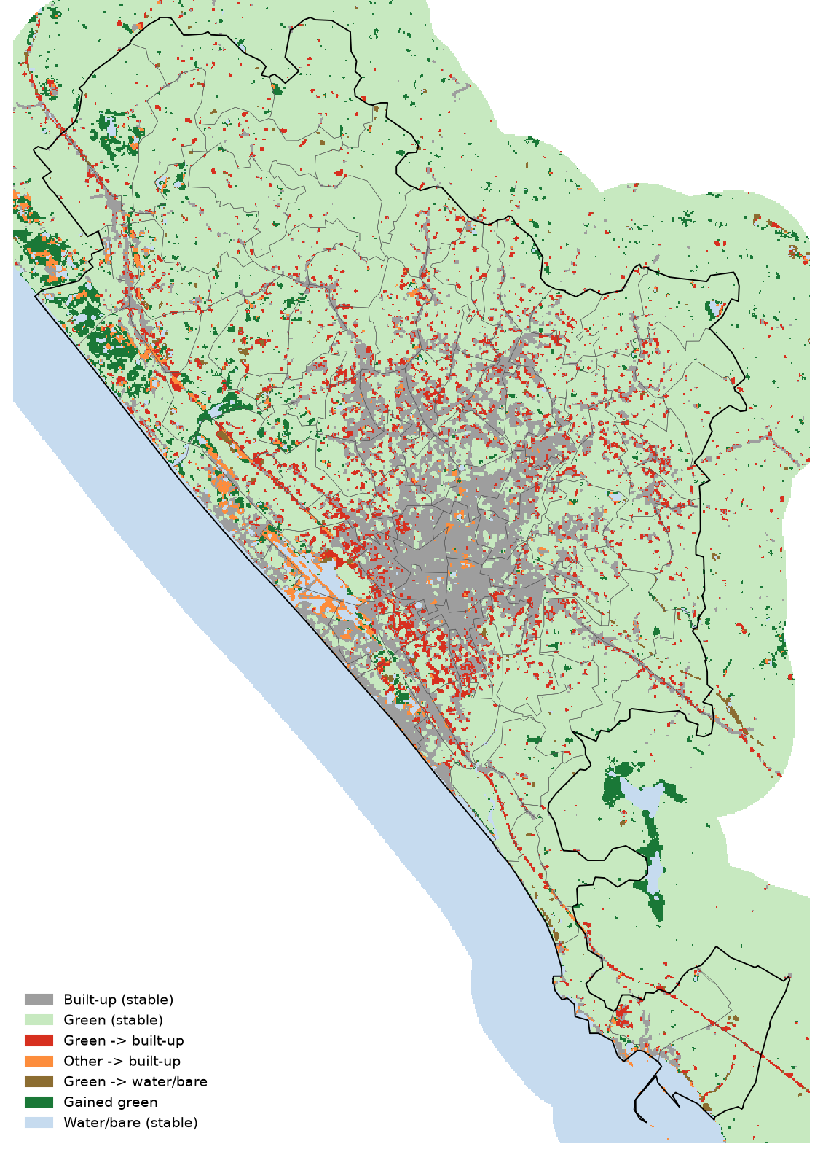
Built-up grew from 15.6% to 22.9% of the city
Green lost per year (km²)
0.71
0.62
0.52
2000-2010
2010-2017
2017-2025
Notes:
Independent Landsat maps per year gave a flat built-up trend, so the series was backdated from 2025 with change-vector detection; the threshold k = 0.25 was chosen so the trend follows the independent GHSL built-up surface. Loss is slowing: 0.71 km2 a year in the 2000s, 0.52 since 2017.

Slide 9
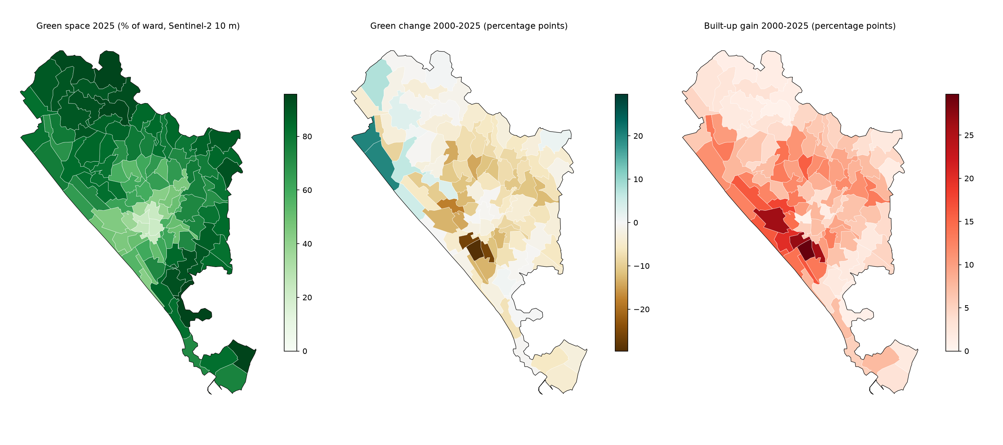
Six wards lost more than 14 points of green cover
Largest green loss, 2000-2025 (pp)
Kamaleswaram
-29.6
79 → 49%
Sreevaraham
-26.1
55 → 28%
Kalippankulam
-25.9
61 → 35%
Pettah
-18.0
62 → 44%
Kesavadasapuram
-14.3
The loss is concentrated in the southern and central wards around the old city. North-west coastal wards show apparent gains, partly because the 2000 map over-counts bare sand there.
62 → 47%
Perunthanni
-14.2
24 → 10%
Notes:
Ward maps of green share in 2000 and 2025 and the change. Gains in the north-west coastal wards (Pallithura, Powndukadavu) are partly an artefact: the 2000 map has too much bare/sand there.

Slide 10
A spatial index makes the 4 M-point join 64× faster
192 s → 3.0 s
Broadcast R-tree index join vs plain Spark nested loop at 4 M points
2× faster
Quadtree vs KDB-tree partitions: better load balance (variation 0.44 vs 1.79)
1.6 s
GeoPandas: 4 M points still fit one machine. Sedona wins when data outgrows it
Notes:
R-tree
R-tree is a spatial indexing method that helps find geographical objects quickly. It organises objects using rectangular bounding boxes. Instead of checking every ward to find where a satellite pixel belongs, it first checks which bounding boxes are nearby and then checks the actual geometry. It saves processing time.
Remember: R-tree = Quickly finds the possible geographical location.
Quadtree
Quadtree is a spatial partitioning method that divides a geographical area into four smaller sections. Each section can be divided into four more sections if needed. This continues until the data is divided into manageable groups. In our project, it helped distribute satellite pixel points more evenly for processing.
Remember: Quadtree = Divides geographical space into four smaller areas repeatedly.
Sedona Nested Loop
Sedona Nested Loop is a basic spatial join approach that compares points with polygons to find which polygon contains each point, without using an efficient spatial index to narrow down the search. Imagine checking many ward boundaries one by one for every satellite pixel. This can become slow when processing millions of points.

Slide 11
PostGIS indexes cut queries up to 115×; all engines agree
Ward statistics as a MapReduce job
Map
pixel → ward (index join)
Combine
partial count per task
Shuffle
hash by (ward, class)
Reduce
count → km² per ward
Three engines agree
Sedona vs Rasterio: within 0.53 pp
PostGIS vs Sedona: identical counts
Pixel table vs raster: within 0.006 km²
Notes:
1. MAP – Assign pixels to wards
Identify which ward contains each satellite pixel using a spatial index and spatial join.
2. COMBINE – Calculate partial counts
Each processing task counts its green pixels separately for each ward.
3. SHUFFLE – Group the results
Group the partial counts using ward ID and land-cover class.
4. REDUCE – Calculate final area
Add all partial counts for each ward and convert the pixel count into square kilometres.
Suppose three tasks process pixels from Ward A:
Task 1 finds 300 green pixels.
Task 2 finds 400 green pixels.
Task 3 finds 300 green pixels.
Reduce adds them:
\[ 300+400+300=1000 \]
For a 10 m Sentinel-2 pixel:
\[ 1000 \times 100=100,000\ m^2 \]
That equals 0.1 km² of green area.
Imagine we have 30 partitions:
Partition 1: Location A
Partition 2: Location B
Partition 3: Location C
...
Partition 30: Other locations
If our query needs data from Location B, PostgreSQL can read the relevant partition and skip the others.
This is called partition pruning

Slide 12
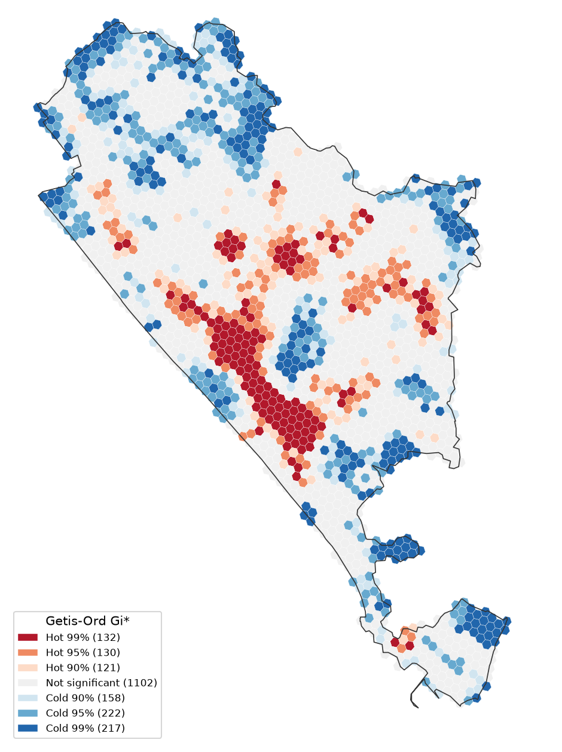
Conversion is concentrated in one central-southern belt
0.49
262
Moran's I of conversion across hexagons (p = 0.001)
Hot hexagons at 95% (115 survive the false-discovery correction)
4.5 km²
250
of the 12.2 km² conversion lies in those hot hexagons
DBSCAN clusters holding 58% of converted pixels
Largest clusters: Sreevaraham 0.44 km², Kalippankulam 0.40 km², Chakkai 0.28 km², Karikkakam 0.18 km²
Notes:
Epsilon (eps) = 100 metres: It looks for nearby converted pixels within a 100 m distance.
Minimum points = 12: At least 12 nearby points are needed to form a cluster.

Slide 13
Infill near the centre and along roads drives conversion
Reading: green pockets already surrounded by buildings in 2000, on flat land within 3 km of the centre, converted at 39%, 5.3× the city rate. Green within 100 m of a main road converted 3.5× as often as green beyond 500 m.
Notes:
1. Main objective
To understand which geographical conditions are associated with green spaces changing into built-up areas.
We used FP-Growth to identify combinations of conditions associated with conversion.
2. Left graph – FP-Growth rules
FP-Growth is a data-mining algorithm that finds frequently occurring combinations of conditions.
We considered factors such as surrounding buildings, distance from the city centre, elevation, road distance and slope.
The graph shows the top five combinations associated with green-to-built-up conversion.
Important rules:
5.3× lift: Existing buildings around + within 3 km of city centre + flat land.
4.8× lift: Existing buildings around + elevation 10–30 m + road distance 250–500 m.
4.8× lift: Existing buildings around + elevation below 10 m.
4.8× lift: Existing buildings around + flat land + dense ward.
4.4× lift: Within 3 km of centre + elevation 10–30 m + flat land.
3. What is lift?
Lift measures how strongly a combination of conditions is associated with conversion compared with the overall city conversion rate.
Citywide conversion rate = 7.42%.
First rule conversion rate = 39.4%.
\[ Lift = \frac{39.4}{7.42}=5.3 \]
Therefore, the first combination had a conversion rate 5.3 times the citywide rate.
Lift does not mean 5.3 times more land was converted.
4. Right graph – Conversion by distance to main road
Distance from main road
Conversion rate
Within 100 m
12.5%
100–250 m
8.3%
250–500 m
6.7%
Beyond 500 m
3.6%
Interpretation:
Green spaces closer to main roads had higher conversion rates.
Within 100 m, conversion was 12.5%.
Beyond 500 m, conversion was only 3.6%.
This indicates an association between road accessibility and green-space conversion.
5. Overall conclusion
Conversion was more common near existing buildings.
Areas closer to the city centre experienced higher conversion.
Flat areas and densely developed wards showed important associations.
Green spaces closer to main roads had higher conversion rates.
Urban expansion tends to fill available green spaces within already-developed areas and along accessible road corridors.

Slide 14
Converted land runs hotter; green per person falls
Floods
People
7.8%
139 → 132
of low-lying green land converted (upland 7.2%)
m² of green per person, 2017 → 2025
2.95 km²
23 → 27
of floodplain-belt green lost to buildings
wards below 50 m² of green per person
Heat: converted pixels warmed 1.6 °C more than green that stayed
Notes:
LST: Converted green areas experienced a 3.0°C temperature increase, compared with 1.5°C in stable green areas.
Heat impact: Converted areas warmed approximately 1.6°C more than green areas that remained green.
Floods: Low-lying green areas had a 7.8% conversion rate, compared with 7.2% in upland areas.
Floodplain loss: Approximately 2.95 km² of floodplain-belt green land was converted into buildings.
Green per person: Decreased from 139 m² in 2017 to 132 m² in 2025.
Ward situation: Wards below 50 m² of green space per person increased from 23 to 27.

Slide 15
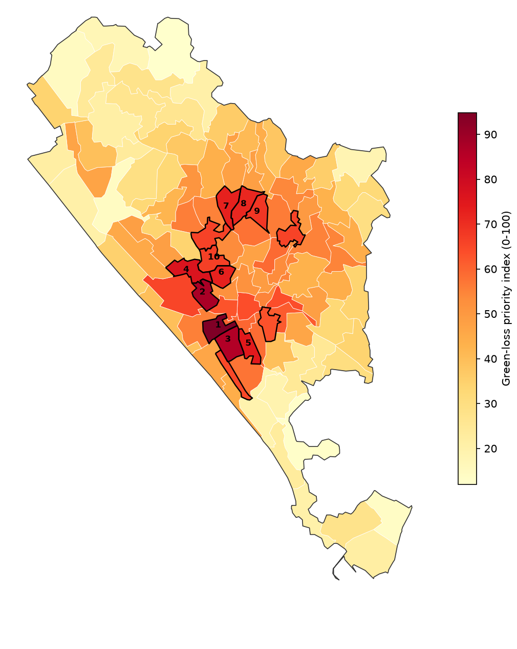
Twenty wards to protect first
Rank | Ward | Index | Rank range
1 | Sreevaraham | 95 | 1-1
2 | Perunthanni | 88 | 2-4
3 | Kamaleswaram | 86 | 2-3
4 | Pettah | 77 | 3-13
5 | Kalippankulam | 74 | 5-19
6 | Vanchiyoor | 73 | 4-13
7 | Kesavadasapuram | 73 | 6-11
8 | Muttada | 71 | 7-9
Notes:
Priority index: seven indicators scaled 0 to 1 (green loss 2000-2025 and 2017-2025, share of ward in Gi* hotspots, share of low-lying green converted, dry-season LST, green per person, population density), equal weights. Re-ranked under loss-pressure, climate-risk and people-first weightings: Spearman rho at least 0.97 and 16 to 19 of the top 20 shared. Rank range shows the best and worst rank across the four schemes.

Slide 16
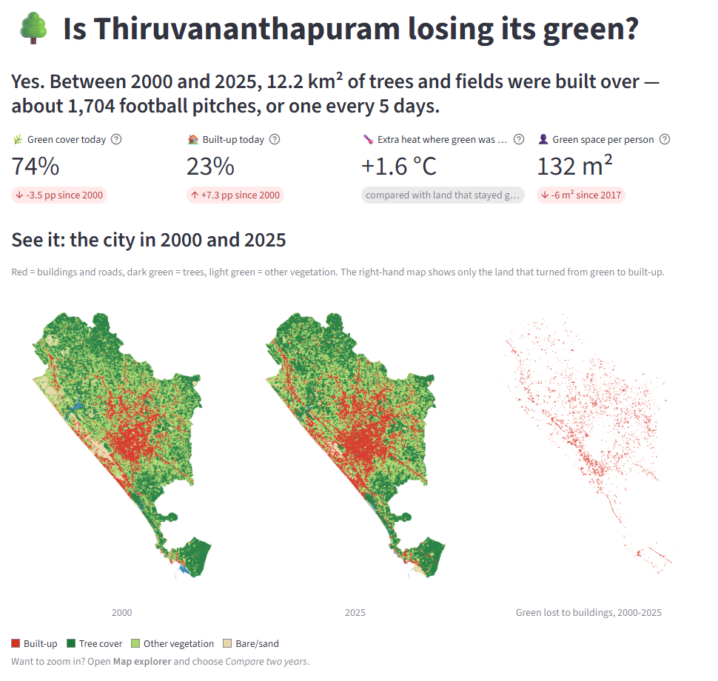
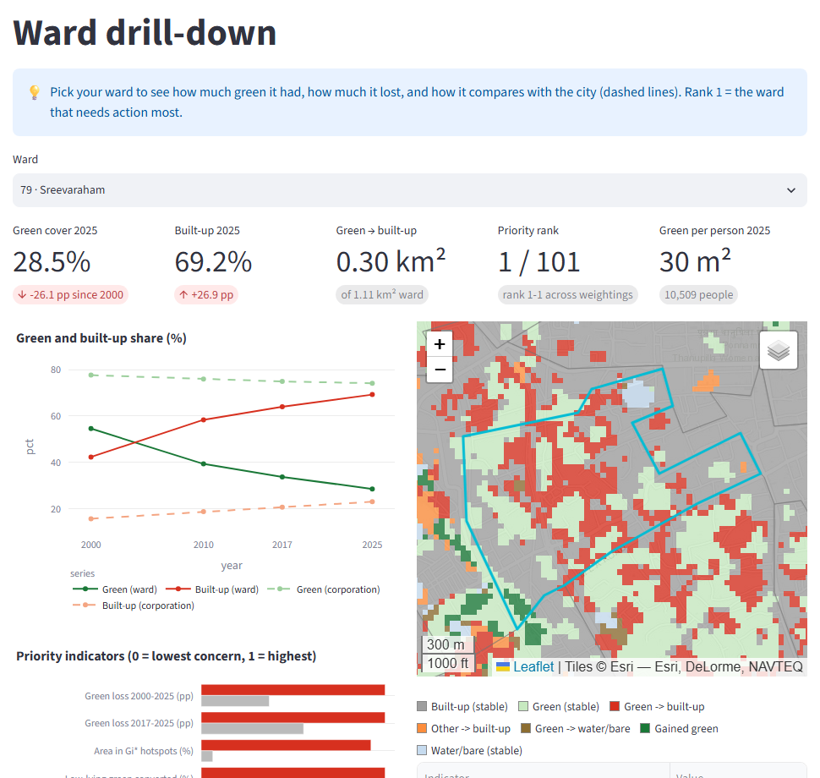
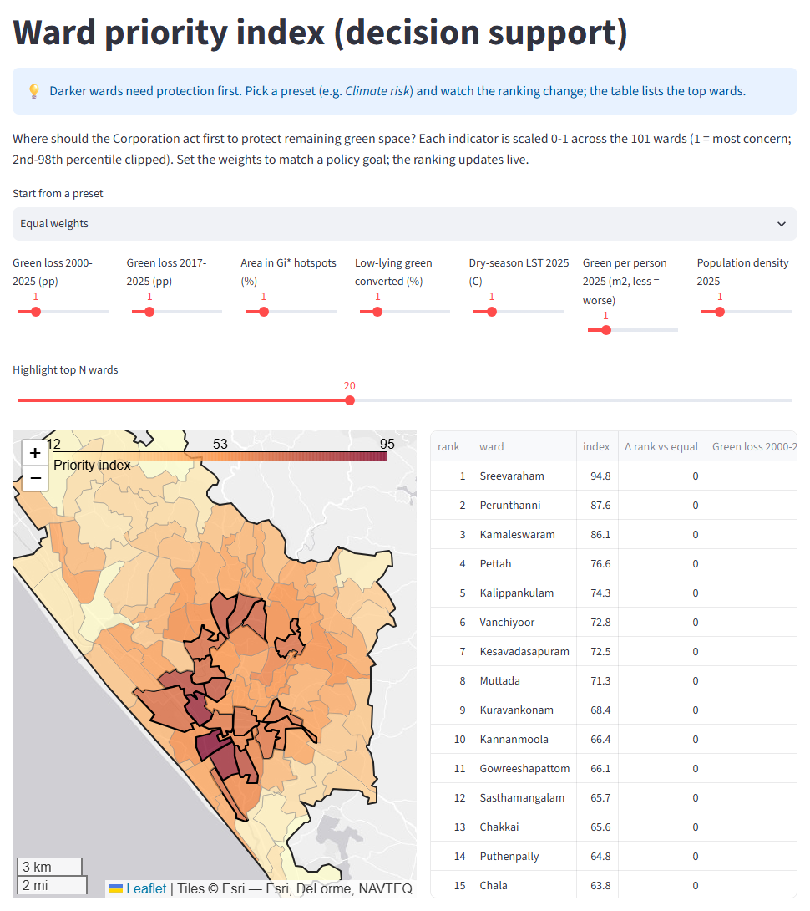
A dashboard puts the results in planners' hands
Overview: the answer in one line, then maps and charts
Ward drill-down: trend, indicators, map
Priority: set the weights, the ranking updates
Year slider and compare
Click a ward to drill down
Gi* and DBSCAN layers
Live PostGIS spatial query
Adjustable priority weights
CSV and GeoJSON export
Notes:
Streamlit app with seven pages. The overview tells the story in plain language: a one-line answer, four headline numbers with explanations, 2000 and 2025 maps side by side, and charts whose titles state the finding. Other pages: map explorer (year slider, side-by-side compare, layer control), ward drill-down, hotspots and rules, spatial query (draw a polygon or buffer a point, answered live by PostGIS SQL or locally), priority index with adjustable weights, and the big-data benchmarks. Every view exports CSV or GeoJSON. Run with: streamlit run dashboard/app.py

Slide 17
CONCLUSION
Protect the green that is left where the pressure is highest
12.2 km²
5.3×
20 wards
of green became built-up in 25 years, mostly as infill in one central-southern belt
the city's conversion rate where green pockets sit inside built-up areas near the centre
stand out under every weighting, led by Sreevaraham, Perunthanni and Kamaleswaram
Thank you · Questions?
Notes:
Close on the three numbers: how much, why, and where to act. The dashboard can be opened live for questions.

